Slide 1
ECE/CS 552: Single-Cycle Data Path
Boone Severson
Lecture notes based in part on slides created by Joshua San Miguel, Mikko Lipasti, Mark Hill, David Wood, Guri Sohi, John Shen and Jim Smith

Slide 2
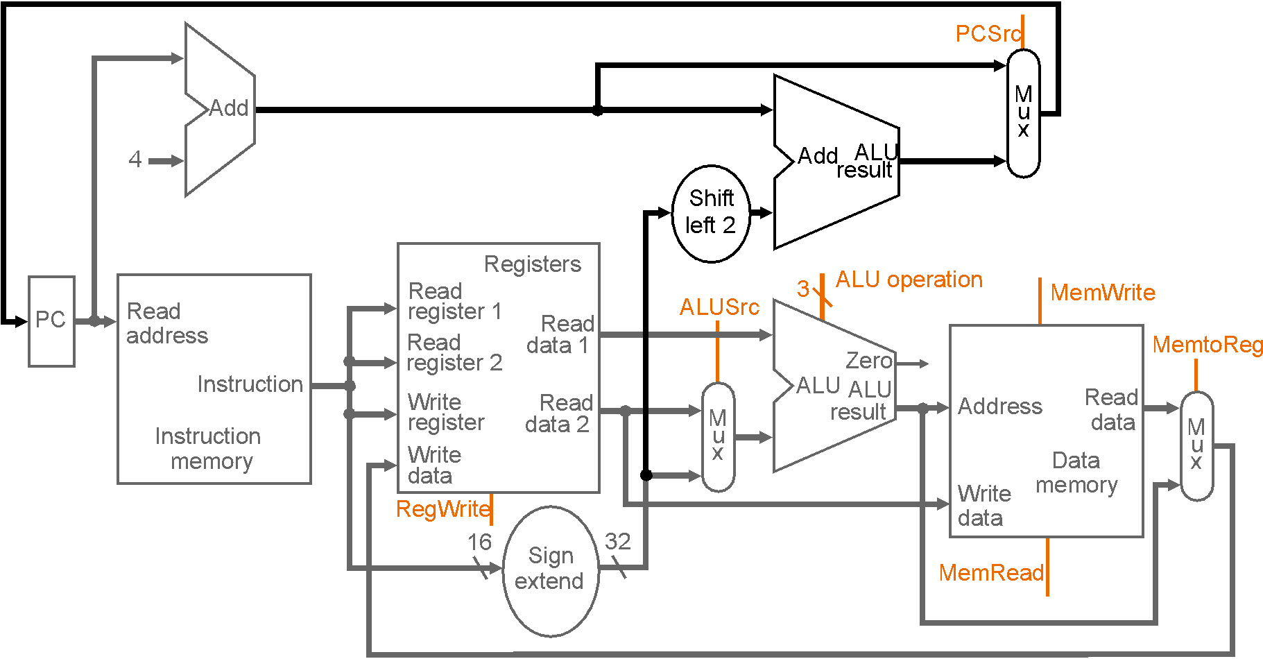
Single-Cycle Data Path

Slide 3
Exercise
If no ALUSrc mux, beq $t0, $t1, LOOP correct?

Slide 4
Exercise
If no ALUSrc mux, beq $t0, $t1, LOOP correct?
0
1

Slide 5
Exercise
If no ALUSrc mux, beq $t0, $t1, LOOP correct?
  No, would compare: [$t0] == LOOP
0
1

